Slide 1

DS Job Market Analysis
DATA11001
Introduction to Data Science
University of Helsinki

Slide 2



Introduction

Slide 3
Why we are different from other tools
1. Tailored for Data Science Students - Specifically designed to meet the unique needs of data science students at the University of Helsinki.
2. Localized Recommendations - Focus on job postings in the Helsinki area, ensuring relevance to students’ geographical preferences.
3. Advanced Matching Algorithms - Utilizes TF-IDF and Cosine Similarity for precise matching based on skills and project experience.
4. Continuous Improvement Through Feedback - Incorporates user feedback to refine recommendations, adapting to the changing job market.
5. Focus on Job Fit - Prioritizes matching based on qualifications and interests, improving overall job satisfaction.
6. Personalized User Experience - Delivers tailored job suggestions based on individual profiles, including skills and desired work arrangements.
7. Unique Features - Offers exclusive tools like skill assessments and mentorship opportunities to enhance the job search experience.

Slide 4


Data Preprocessing
Inbuilt data scraper : APIFY Platform: LinkedIn Jobs posted: Aug 12 - Oct 12 Data format: csv files | Combine CSV files No of records:755

Slide 5


Data Preprocessing cntd.
Remove identical records Remove records with null values No of records:561 | Language Translation (Finnish → English) Create new variables

Slide 6
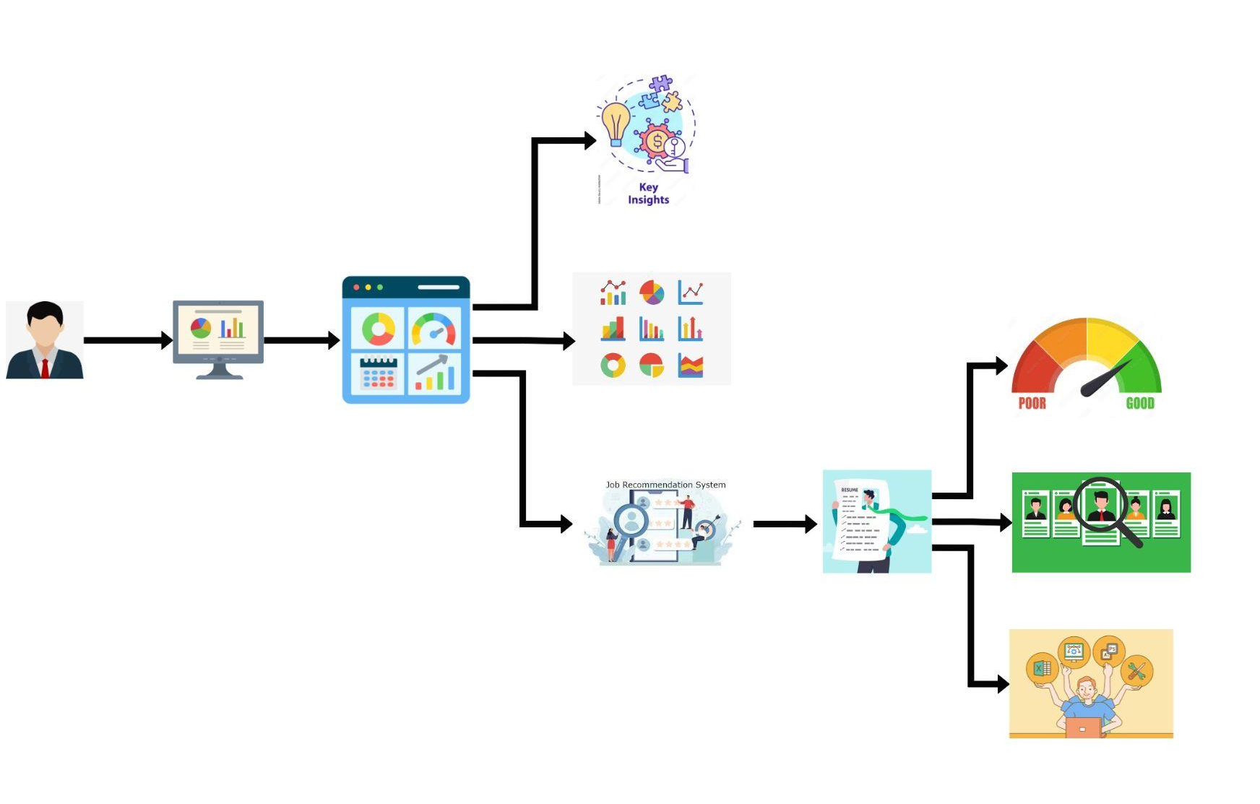
Dashboard
Key Insights
Dashboard
User
EDA
User Inputs
CV Score
Job Recommendation Tool
Top 10 Jobs
Skill Enhancement Suggestion

Slide 7

Q & A

Slide 8

Our Group
Gayathri Senanayake
Dilusha Senarathna
Kavya Atapattu

Slide 9


Slide 10
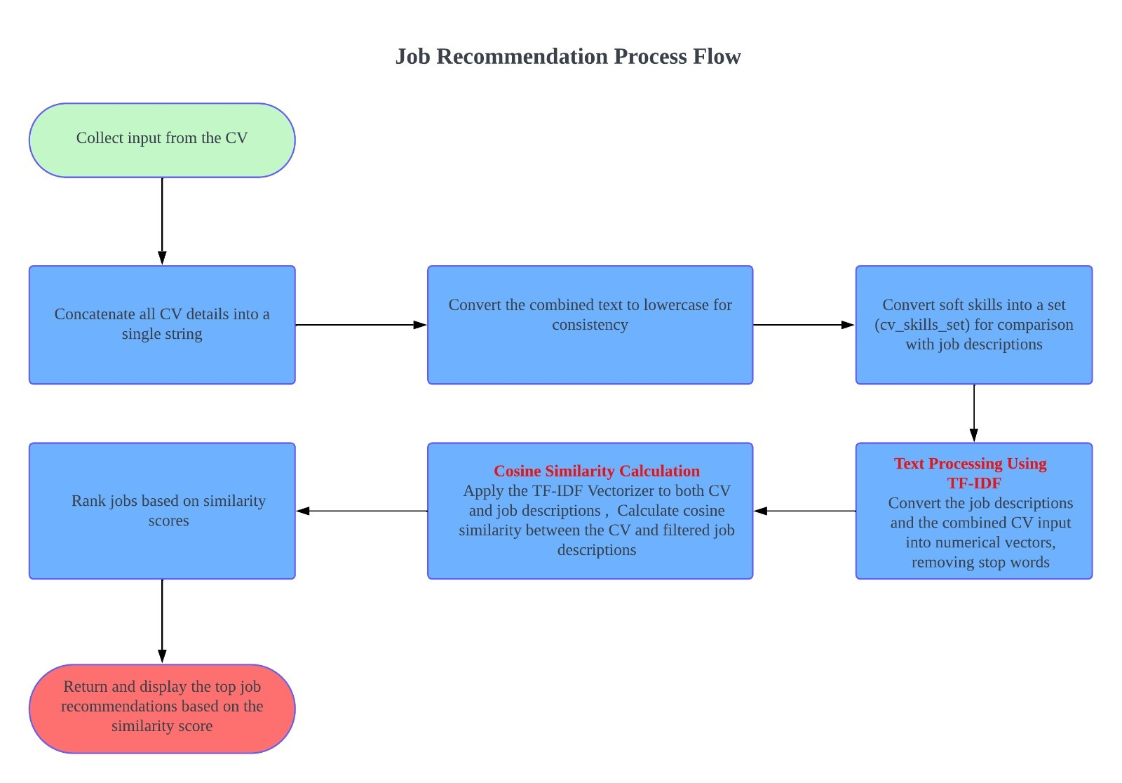

Slide 11
Feature Engineering
Columns of original dataset: (20 Columns)
applications_Count, applyType, applyUrl, companyId, company_Name, companyUrl, contract_Type, Description, experience_Level, jobUrl, location, posted_Time, posterFullName, posterProfileUr, publishedAt, Salary, Sector, Title, workType, Work_arrangement
New Variables: (37 Columns)
Existing column | New Variables
Description | Programming languages, Data Engineering techniques, Database Applications, Soft skills, Cloud computing techniques, Company level
posted_Time | Weeks
Title | Job Title (Engineer, Manager, Programmer)
applications_Count | Intervals

